Slide 1
Investigation: examining short-term memory through the serial position effect
Year 12 ATAR Investigation
Assessment 3
Weight: 7.5%
Experiment in class – 1st April
Complete write-up in class – 5th and 6th April

Slide 2
Read information letter
Parent/guardian sign consent form if under 18 years old
Start background research on short-term memory and the serial position effect
Prepare half page of notes to assist with introduction (include your reference list)

Slide 3
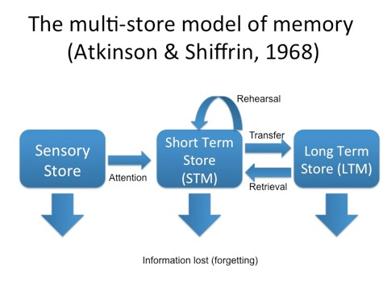
Multi-store Model of Memory → Atkinson & Shiffrin (1968)
Sensory (very brief, transferred to STM if person pays attention to it)
Short-term (limited store of actively conscious memory, transferred to LTM if it has been encoded)
Long-term (like a computer hard-drive, limitless in capacity, needs retrieval to bring it back into conscious awareness)
Notes:
Can be referred to as either STM or WM
Use STM when discussing multi-store memory
Use WM when discussing Baddeley & Hitch Model of WM

Slide 4
Short-term memory
Capacity: 7 (+ or – 2) items
Duration: 12-30 seconds
Function: STM holds information in awareness for a short period of time – long enough to use for mental tasks
Encoding: mostly acoustic. Attention and rehearsal will help store information in LTM.
Forgetting: Displacement and interference.
Example: remembering an address long enough to look it up on an online street map service.
Notes:
Displacement: When STM is 'full', new information displaces or 'pushes out’ old information and takes its place
Interference: memory can be disrupted or interfered with by what we have previously learned or by what we will learn in the future.
Decay:

Slide 5
serial position effect
Experiments show that when participants are presented with a list of words, they tend to remember the first few and last few words and are more likely to forget those in the middle of the list.
This is known as the serial position effect. The tendency to recall earlier words is called the primary effect; the tendency to recall the later words is called the recency effect.

Slide 6
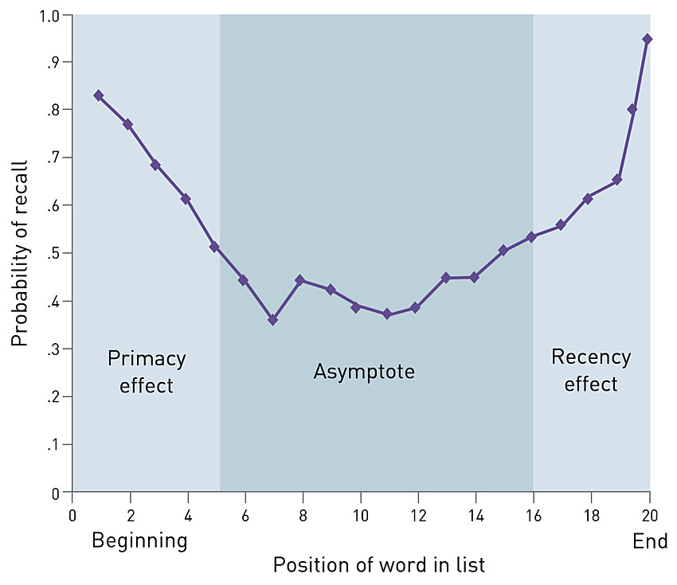
Serial position effect U-shape graph of recall
Notes:
Asymtote – as STM reached capacity, items are displaced before they can be adequately rehearsed and stored in LTM. Items not stored in LTM or are displaced from STM.
Means close to the horizontal. Inferior recall for items in middle of list.

Slide 7
Research past studies
Simply Psychology website:
Murdock (1962) Experiment
Glanzer and Cunitz (1966) Experiment
Refer to previous studied in your introduction!

Slide 8
Investigation write-up
Investigation skills handbook
Structure
Language
Referencing – APA

Slide 9
Conduct experiment
Discuss ethical considerations
Remember the procedure, materials etc for write-up
Starting with informed consent and ending with debrief

Slide 10
In class write-up
Take half page notes in
Investigation skills handbook
Data sheet
Information sheet

